Slide 1
Introduction to the Forecast Impact and Quality Assessment Section
GSD Verification Summit Meeting
8 September 2011
Jennifer Mahoney

Slide 2
FIQAS Team
Paul Hamer
Joan Hart
Mike Kay
Steve Lack
Geary Layne
Andy Lough
Nick Matheson
Missy Petty
Brian Pettegrew
Dan Schaffer
Matt Wandishin

Slide 3
FIQAS - Overview
Mission
Advance the understanding and use of weather information through impact-based assessments and targeted information delivery to benefit decision making in response to high impact weather events
Forecast quality information in context

Slide 4
FIQAS - Overview
Activities
Perform in-depth quality assessments
Develop and apply verification metrics and methodologies
Assess and integrate observation datasets into verification approaches
Generate and maintain historical performance records
Develop and transition verification tools for information delivery
Users
Forecasters
Roles
Quality Assessment Product Development Team
Assessments for FAA product transition
Forecast Impact and Quality Assessment Section (FIQAS)
Verification tool transition
Assessment and guidance to NWS Aviation Services and Performance Branches

Slide 5
FIQAS Overview
Current - Weather variables of interest
Ceiling and visibility
Icing
Convection/precipitation
Turbulence
Cloud top height
Echo tops

Slide 6
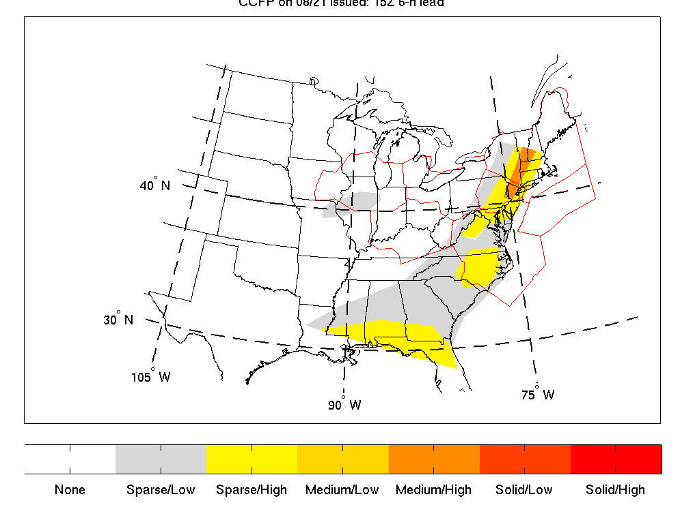
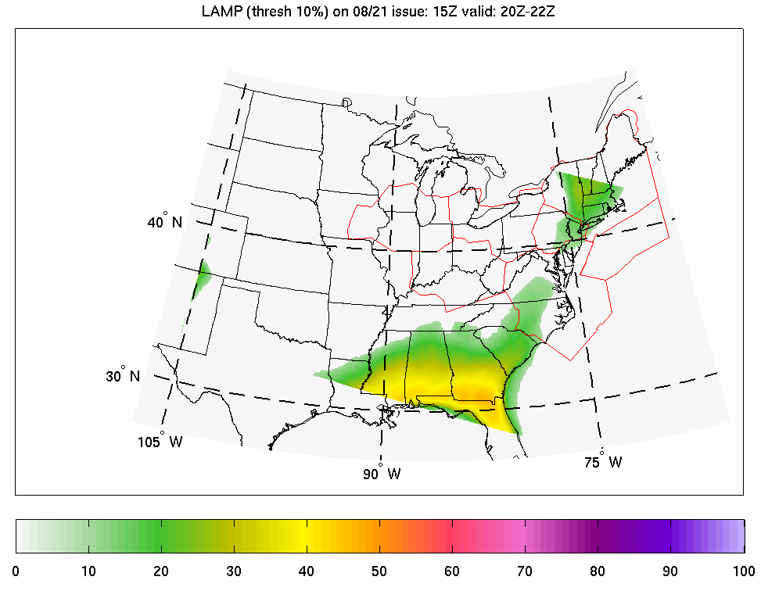
FIQAS Overview
CCFP
Types of forecasts and analyses
Gridded forecast products
Human – generated
Deterministic and probabilistic
Types of observation datasets
PIREPs, EDR, metars, surface, upper air, satellite, radar and radar-derived gridded products, lightning, user products and decision criteria (e.g. airspace flow programs for traffic management - AFPs)
LAMP

Slide 7
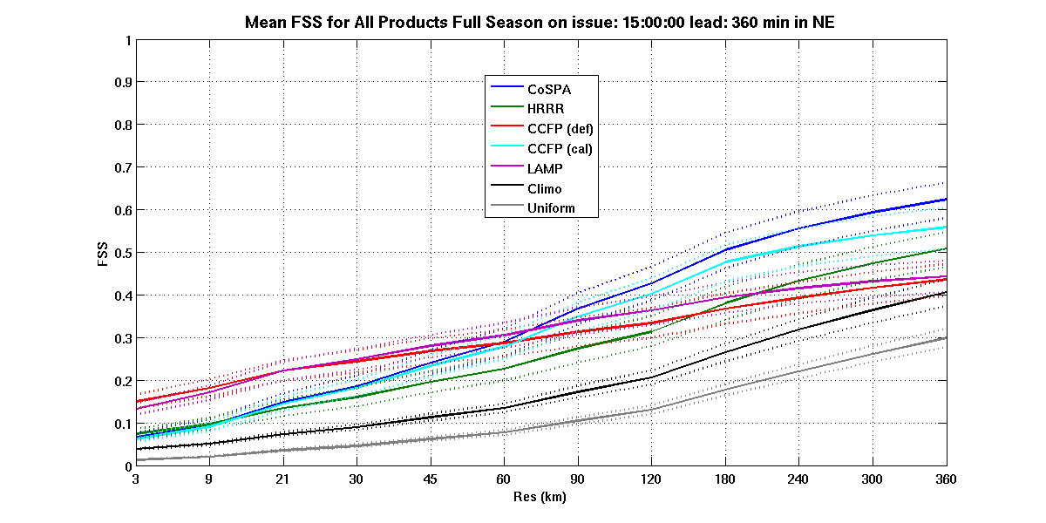
FIQAS Overview
Methodologies
Climatological comparisons
Resolution-based
Consistency
Scaling approach
Event-based
Object-based
Traditional dichotomous
Fractions Skill Score
Resolution

Slide 8
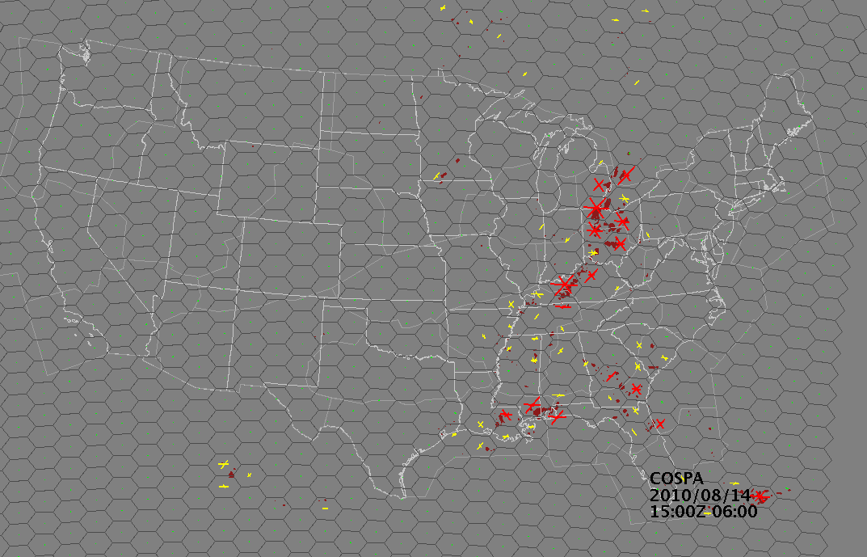
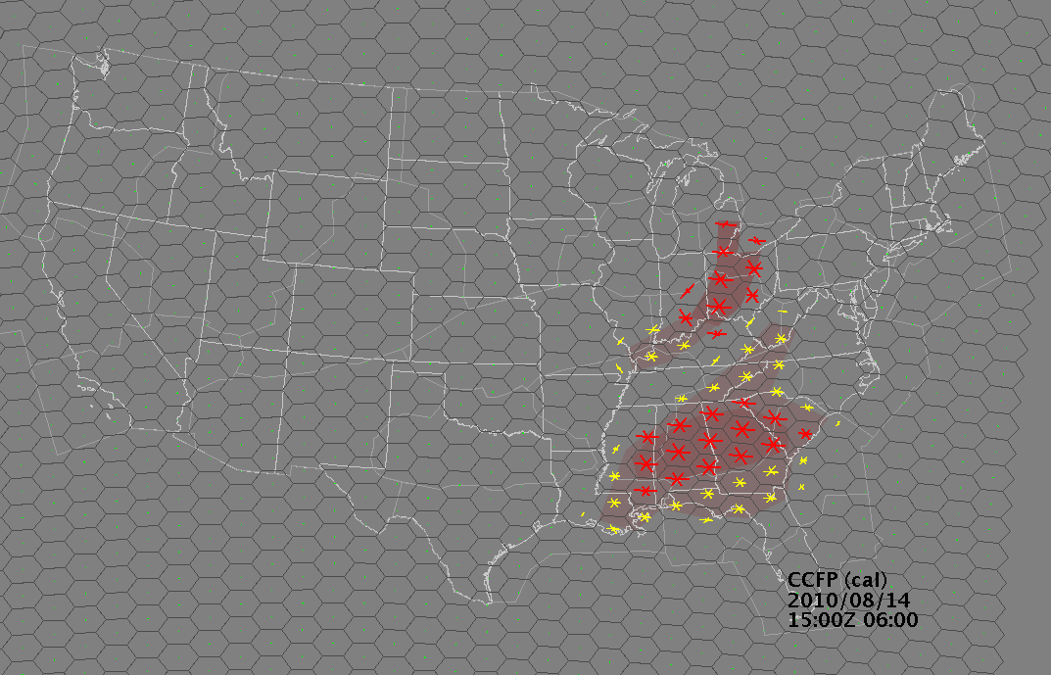
FIQAS Overview
Metrics
Traditional metrics (PODs, FARs, CSI, errors, TSS, FSS, ROC etc.)
Impact-based metrics (Flow Constraint Index
Lead-time metrics (onset and cessation of events)
Displacement/location errors
Matching techniques
Grid to grid
Grid to point
Point to Polygon
Pixel-to-Pixel
Event-to-Event
Flow Constraint Index
CoSPA
CCFP

Slide 9
FIQAS Overview
Stratifications
Operational decision criteria
Meteorological (storm type)
Forecast specific (lead/issue etc)
Geographic
Global, national and regional domains
Operational domains (e.g. terminal, sector, ARTCC)
Types of Assessments
Historical performance monitoring
Product intercomparisons (strength and weaknesses)
Supplemental comparisons (forecasts used together)
Head-to-head comparisons (replacement of forecasts)
Forecaster ‘value-added’

Slide 10
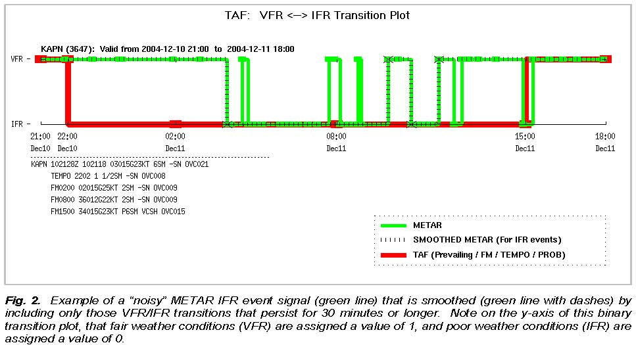
FIQAS Overview
Web-based Verification Technologies
Network-Enabled Verification Service (NEVS)
Verification, Requirements, and Monitoring Capability (VRMC)
TAF lead-time tool
Real Time Verification System (RTVS)
Formal Forecast Assessments
Evaluate forecast quality in support of FAA product transitions
Evaluations for NWS feedback and funding decisions
Technologies for NWS transition
TAF Lead-Time Tool – Event Transition Plot

Slide 11
Presentations Today
FIQAS Verification Technologies – Missy Petty
An Object-based Technique for Verification of Convective Initiation - Steve Lack
More info at the FIQAS home page
http://esrl.noaa.gov/gsd/ab/fvs/

Slide 12
Backup

Slide 13
Methodology Overview

Slide 14
ARTCC and Sector Image
ARTCC Boundaries (blue) with high altitude sector boundaries (red).

Slide 15
Fractions Skill Score (FSS)
High resolution forecasts often suffer when viewed with basic categorical skill scores (pixel-to-pixel-based verification)
The FSS accounts for spatial displacements between forecasts and observations (finds the benefit in high resolution products)
Used to bring products of varying types to a common playing field without changing product definitions
There is no need to threshold probabilities or coverages in LAMP or CCFP to turn them into dichotomous (yes/no) forecasts before scoring

Slide 16
From Ebert, 2nd QPF Conference, Boulder, CO, 5-8 June 2006

Slide 17
Fractions Skill Score: Northeast Domain
Fractions Skill Score versus resolution (km) for all products, 1500 UTC issuance, 6-h lead. CoSPA and Calibrated CCFP begin to show reasonable skill at ~60km, the typical scale of a high-altitude sector. Coarse scale of LAMP and Uncalibrated CCFP evident in relatively flat curves. Bootstrap confidence intervals shown as dotted lines.

Slide 18
Mincut Bottleneck Technique
Metric based on orientation and amount of convective hazards in a constrained space (airspace permeability)
Like the FSS, all products are treated by definition without the need for thresholding the probabilistic/categorical forecasts (LAMP/CCFP)
Two resolutions are used in this study, one with a resolution similar to high altitude sectors and a second similar to ARTCC sizes
This technique allows for an assessment of spatial skill at different levels of permeability

Slide 19
Mincut Bottleneck
Illustration of the Mincut Bottleneck technique for a hexagonal grid; note that hazards can be defined by weather attributes or weather avoidance objects, and can be deterministic or probabilistic.

Slide 20
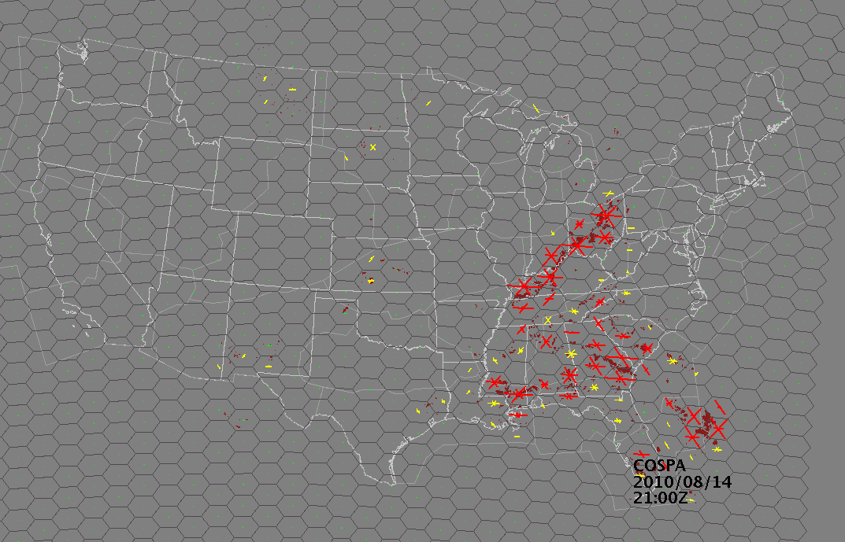
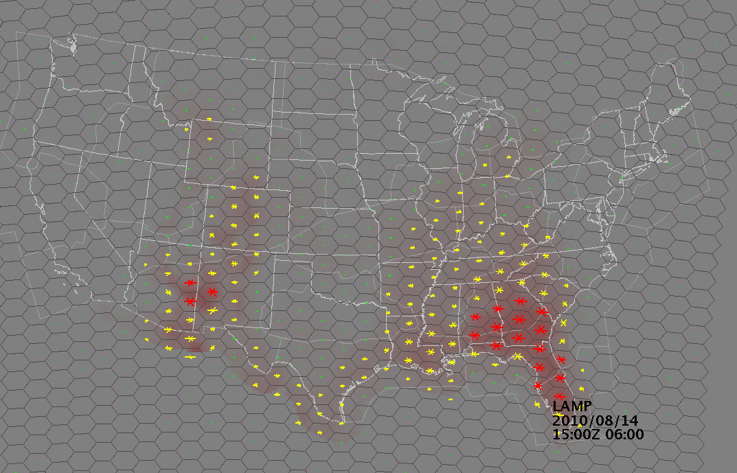
Mincut Example 14 Aug 2010, valid 2100 UTC, 6-h lead
CIWS Analysis
CoSPA Forecast
CCFP Forecast
LAMP Forecast

Slide 21
Mincut Time Series for Indianapolis Center (ZID) 1500 UTC Issuance
CoSPA and CCFP tend to show an increase of convection 4-h ahead of the event at the 1500 UTC issuance although CoSPA has a 1-h lag and CCFP is too weak.

Slide 22
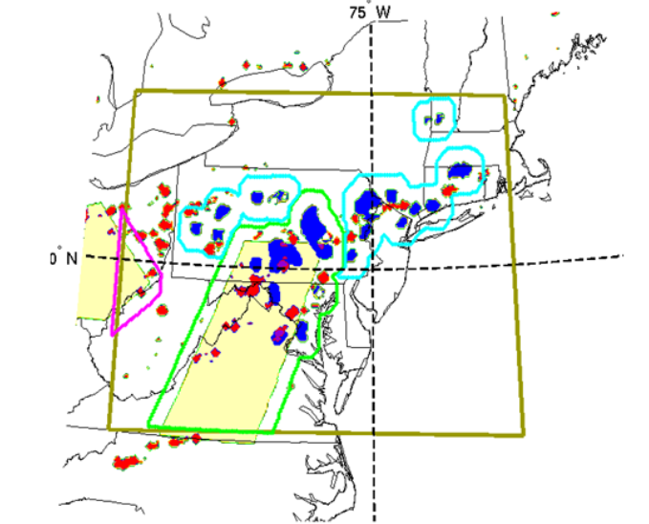
Supplemental Evaluation
Example of domain decomposition for use in the supplemental evaluation.
CCFP is shown in beige, a supplemental forecast is shown in blue and
observations are in red. Forecast agreement of convection is outlined in green,
disagreement in magenta and cyan.
Notes:
SORT OF REMOVABLE

Slide 23
CoSPA as a Supplement to CCFP Findings
CoSPA performs better when co-located with a CCFP polygon (agreement) than when outside a CCFP polygon (disagreement).
When CoSPA forecasts significant areal coverage of convection inside a CCFP sparse coverage/low confidence polygon (typically ignored by the user) CoSPA tends to verify and does so better than LAMP.

Slide 25
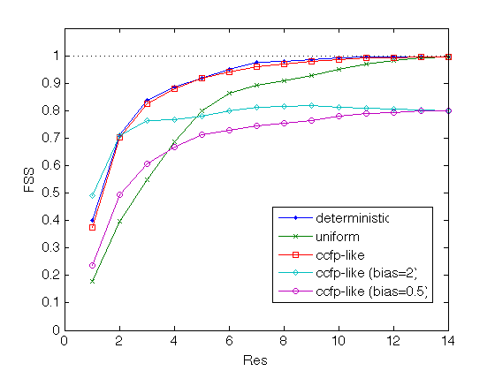
Fractions Skill Score Plot Example
As the resolution approaches the entire size of the forecast domain the forecasts approach a function based on bias. Higher the score the better the forecast.

Slide 26
Simplified Mincut Bottleneck
Illustration of the Mincut Bottleneck technique for a simplified 10x10 grid; note that hazards can be defined by weather attributes or weather avoidance objects, and can be deterministic or probabilistic. This shows Mincut’s roots in graph theory.
Notes:
REMOVABLE

